Slide 1
Introduction to Sampling
Md. Ismail Hossain Riday

Slide 2
Sampling
In order to make any decision about some characteristics, it is necessary to collect and analyze data on it.
To collect such data, the method of collection is important.
This methods are simply define as “Sampling”.

Slide 3
Sampling
Sampling is a process in statistical analysis where researchers take a predetermined number of observations from a larger population.
For example, suppose we want to investigate the percentage of farmers using organic manures in Bangladesh. But, it is not possible to collect information on fertilizer use of all the farmers. In such cases, a part of all farmers is selected using “statistical techniques”. The method is called sampling.

Slide 4
Basic terms
Population
Finite population: Finite number of elements
Infinite population: Infinite number of elements
Sample
Census
Survey/Sample survey
Pilot survey: Small scale surveys are called pilot survey.

Slide 5
Advantages of sampling
Less time, money and labor
Accuracy of results
Greater scope
Overcome the large population problem

Slide 6
Limitations of sampling
Lack of trained and skilled manpower and necessary equipment at the stage of data collection and analysis reduces the reliability of sample survey
If population is not very large, complete enumeration gives better results than sample survey

Slide 7
Steps in sample survey
Defining objectives
Defining the population to be sampled
Sampling design
Set data collection method
Structured questionnaire
Administration of the survey
Data processing & Analysis

Slide 8
Errors in Sample survey
Two types of errors may involve in the collection, organization and analysis of the data.
Sampling error: This is originated in the sampling process.
Non-sampling error: Arise at different post sampling stages.

Slide 9
How to reduce errors?
Increase the sample size usually reduces the sampling error.
Non-sampling error may be reduced to a great extent by proper planning, using appropriate techniques, employing experienced and skilled manpower, preparing a good questionnaire and proper reporting.

Slide 10
Sampling methods
There are two types of sampling methods,
Probability Sampling
Non probability sampling
Principle of randomization is used
Principle of randomization is not used

Slide 11
Types of probability sampling
Four types of probability sampling
Simple Random Sampling
Systematic Sampling
Cluster Sampling
Stratified Sampling

Slide 12
Simple Random Sampling
A simple random sample is a randomly selected subset of a population.
In this sampling method, each member of the population has an exactly equal chance of being selected.
This method is the most straightforward of all the probability sampling methods

Slide 13
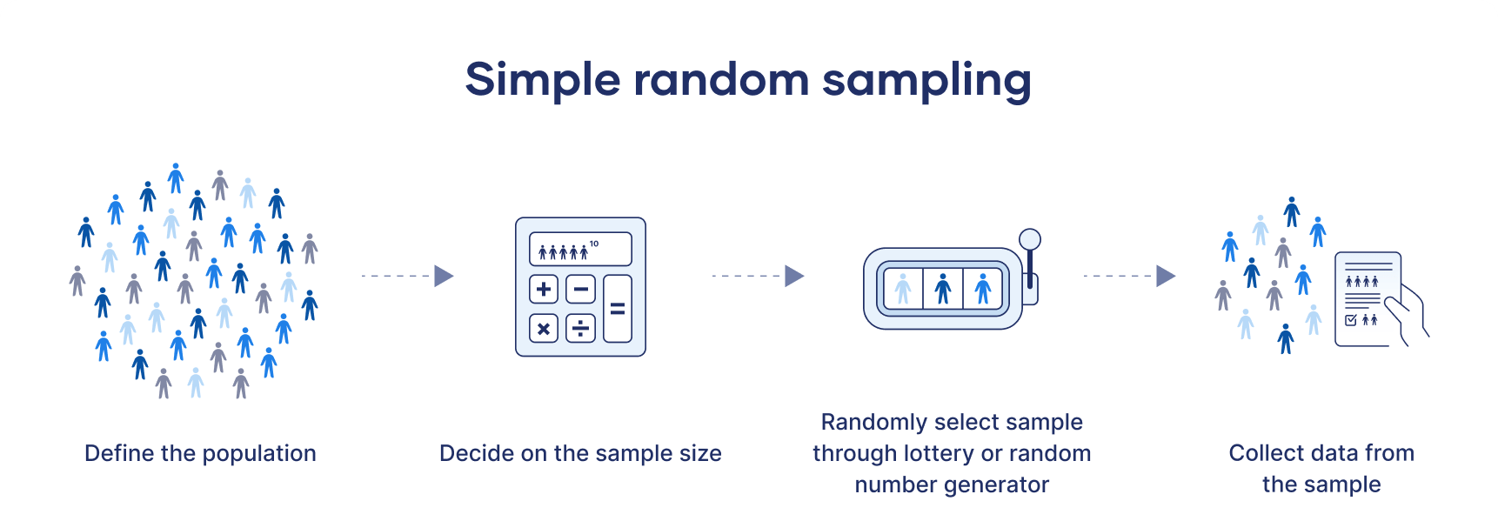
Simple Random Sampling

Slide 14
Simple Random Sampling
A university wants to conduct a survey to understand the study habits of undergraduate students across all departments. The university has 5,000 undergraduate students enrolled, and the administration decides to survey 200 students. To ensure fairness, they want each student to have an equal chance of being selected. What sampling technique? How can the university implement this technique to select 200 students?

Slide 15
Some challenges…
You have a complete list of every member of the population.
You can contact or access each member of the population if they are selected.
You have the time and resources to collect data from the necessary sample size.
Simple random sampling works best if you have a lot of time and resources to conduct your study, or if you are studying a limited population that can easily be sampled.

Slide 16
Systematic Sampling
Systematic sampling is a probability sampling method in which researchers select members of the population at a regular interval (or k) determined in advance.
If the population order is random or random-like (e.g., alphabetical), then this method will give you a representative sample that can be used to draw conclusions about your population of interest.

Slide 17
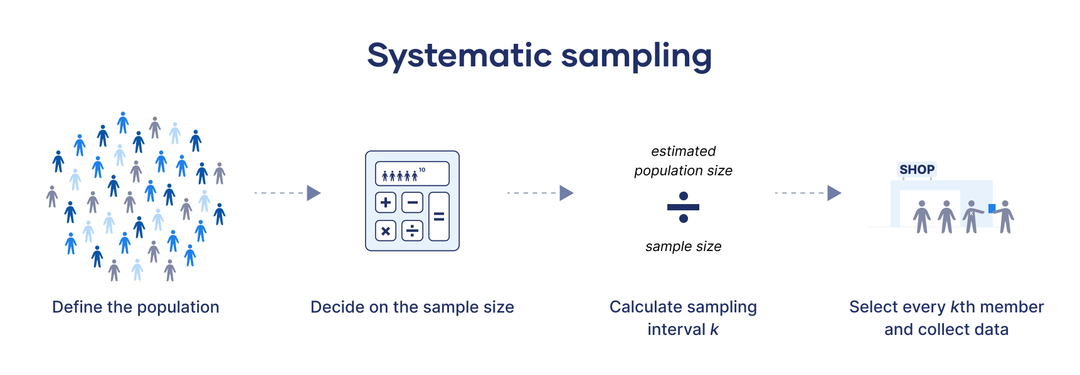
Systematic Sampling

Slide 18
Systematic Sampling
You run a department store and are interested in how you can improve the store experience for your customers.
To investigate this question, you ask an employee to stand by the store entrance and survey every 20th visitor who leaves, every day for a week.

Slide 19
Cluster Sampling
In this method the population is divided into a required number of mutually exclusive groups of classes.
These groups or classes are known as clusters.
Then some clusters are randomly selected and data are collected from all the units included in these selected clusters.

Slide 20
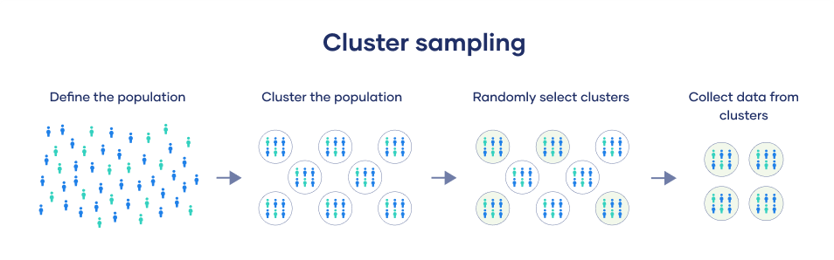
Cluster Sampling

Slide 21
Cluster Sampling
You are interested in the average reading level of all the seventh-graders in your city.
Step 2: Divide your sample into clusters
“You cluster the seventh-graders by the school they attend. To cover the whole population, you need to include every school in the city. There is no overlap because each student attends only one school.”
Step 1: Define your population
“In your reading program study, your population is all the seventh-graders in your city.”
Step 3: Randomly select clusters
“You assign a number to each school and use a random number generator to select a random sample.”
Step 4: Collect data from the sample
“You test the reading levels of every seventh-grader in the schools that were randomly selected for your sample.”

Slide 22
Stratified Sampling
If the population is not homogeneous (the population elements are not similar) in respect of characteristic under study, simple random sampling may not properly represent the population.
In such cases, the whole population is divided into a number of more or less homogeneous groups.
These groups are called “Strata”
From each group, separate random selections of elements are made constitute a sample.

Slide 23
Stratified Sampling
The strata should be such that
Each stratum should be as far as possible of homogeneous nature.
Different strata should be as far as possible of different nature.

Slide 24










Stratified Sampling
In a certain locality there are 600 farmers of whom 400 are small farmers, 150 are medium farmers and 50 are big farmers.
In order to collect data on rice cultivation pattern, a sample of 10% farmers required to drawn.
$$N_{1}=400$$
$$N_{2}=150$$
$$N_{3}=50$$
$$n_{1}=400×10\%$$
$$n_{2}=150×10\%$$
$$n_{3}=50×10\%$$
$$n_{1}=40$$
$$n_{2}=15$$
$$n_{3}=5$$
$$n_{1}+n_{2}+n_{3}=60$$

Slide 25
Types of non probability sampling
Convenience sampling is a non-probability sampling technique where samples are selected from the population only because they are conveniently available to the researcher.
Convenience sampling
Consecutive sampling
Judgmental/Purposive sampling
Quota sampling
Snowball sampling
This non-probability sampling method is very similar to convenience sampling, with a slight variation. Here, the researcher picks a single person or a group of a sample, conducts research over a period, analyzes the results, and then moves on to another subject or group if needed.
In the judgmental sampling method, researchers choose only those people who they deem fit to participate in the research study.
Snowball sampling helps researchers find a sample when they are difficult to locate.

Slide 26
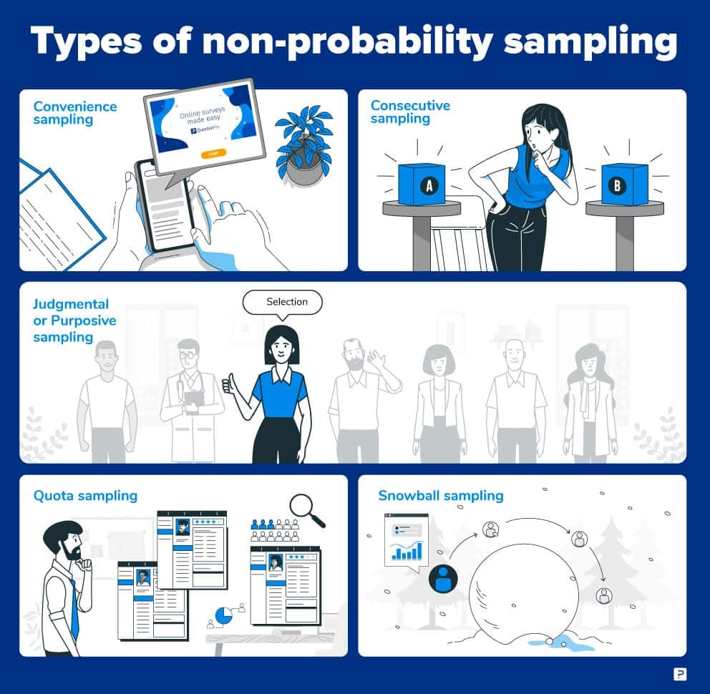

Slide 27
Self Practice
A research team is conduction a study on the employment status of individuals in a large metropolitan city. The city is divided into 10 administrative zones, each with a mix of urban and suburban areas. The population of each zone varies, and the team wants to ensure their study results accurately represent the entire city. Due to budget constraints, they cannot survey the entire population and must use sampling techniques. They are interested studying the following groups:
Unemployed individuals aged 18-35.
Part time workers in suburban areas.
Full time workers in urban areas.
Each administrative zone has a registry of residents with their employment status, age, and address.

Slide 28
Thank You

